Slide 1
LabView Implementation of IIR Chebyshev Filters
By: Md. Sarfraz Siddiqui(1DS15EC067)
Nithin Madhu(1DS15EC076) Prabhu Solomon(1DS15EC081)

Slide 2
Filtering
Filtering is one of the most common signal processing techniques and is the process by which the frequency content of a signal is altered. Some of the practical applications of filtering are in the bass and treble controls of your stereo to adjust the frequency response, in the tuning circuits of your radio and television receivers to select a particular channel, in telephone handsets to limit the frequency content of the sound signals to 3 KHz, and many others in the audio, telecommunications, geophysics, and medical fields.

Slide 3
Infinite Impulse Response Filters
infinite impulse response filters (IIR) are digital filters whose output is calculated by adding a weighted sum of past output values with a weighted sum of past and current input values.

Slide 4
Chebyshev Filters
The frequency response of Butterworth filters is not always a good approximation of the ideal filter response because of the slow rolloff between the passband (the portion of interest in the spectrum) and the stopband (the unwanted portion of the spectrum). On the other hand, Chebyshev filters have a smaller transition region than a Butterworth filter of the same order. However, this is achieved at the expense of ripples in the passband.

Slide 5
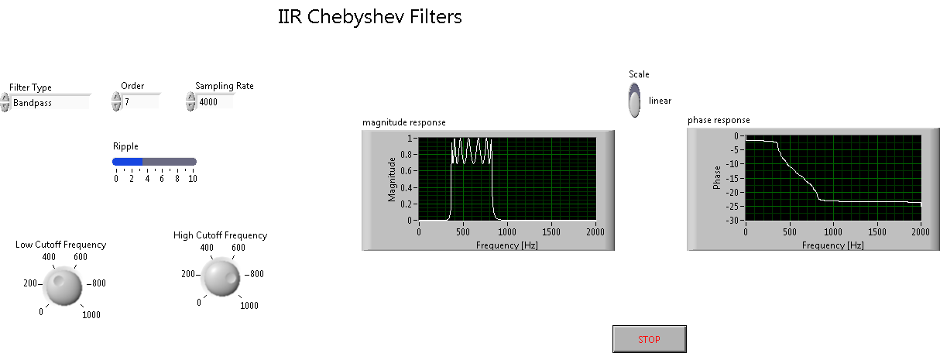
LabView Implementation of Chebyshev Filter

Slide 6
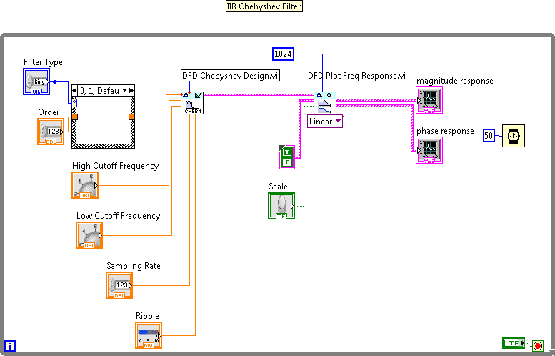

Slide 7
MATLAB code implementation in Labview for IIR Chebyshev Filters

Slide 8
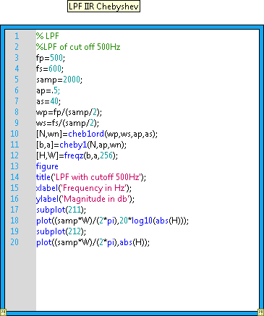
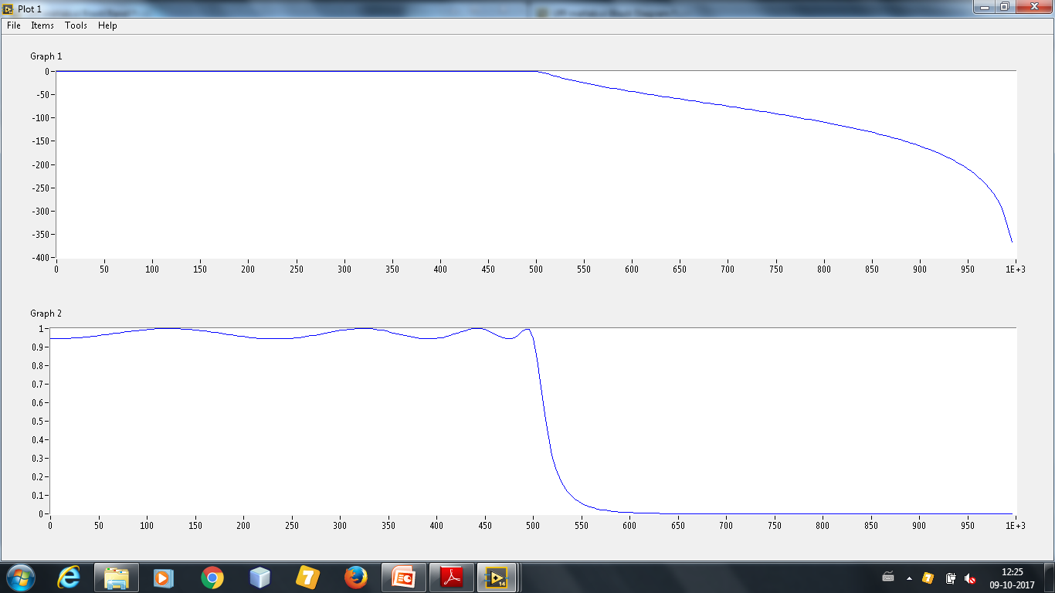
Low Pass Filter

Slide 9
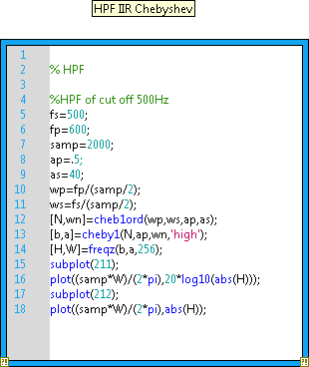
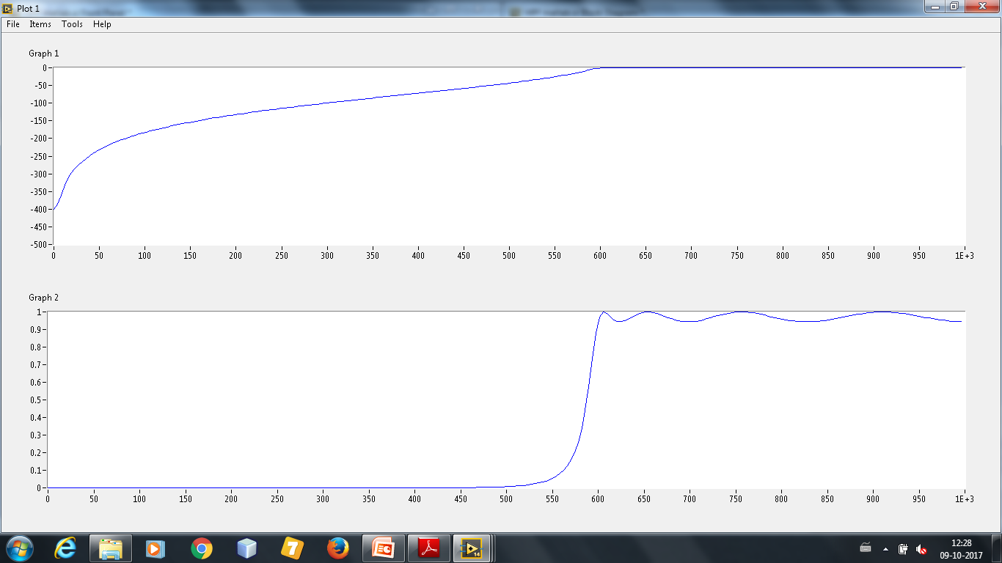
High Pass Filter

Slide 10
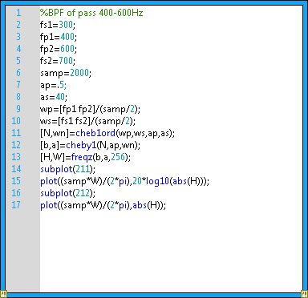
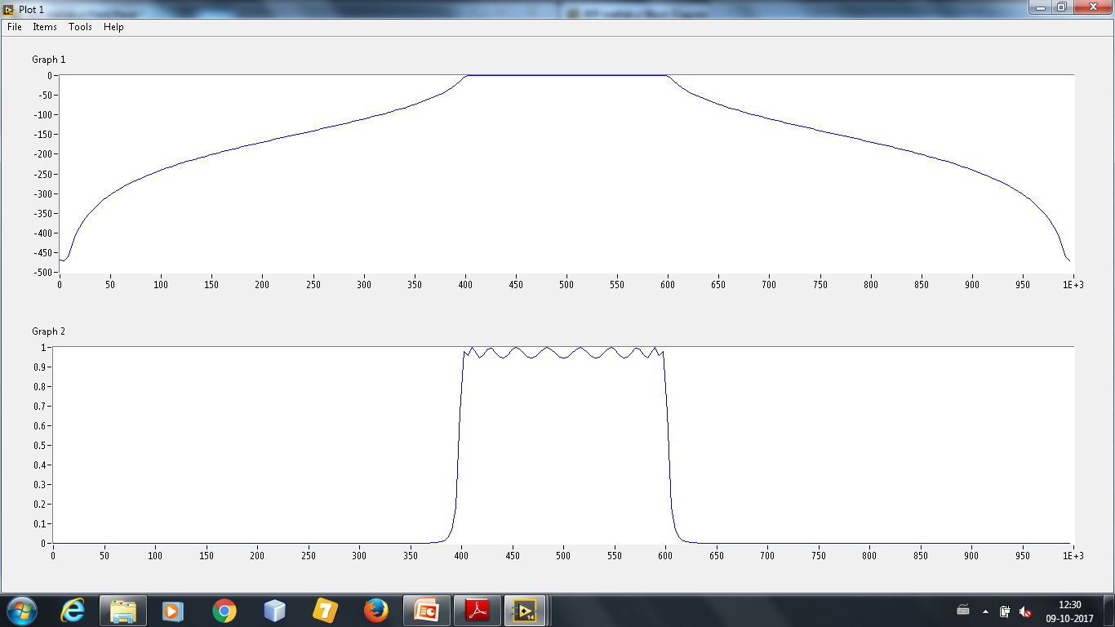
Band Pass Filter

Slide 11
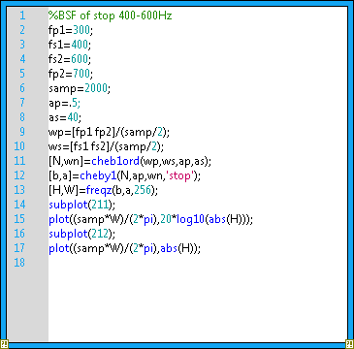
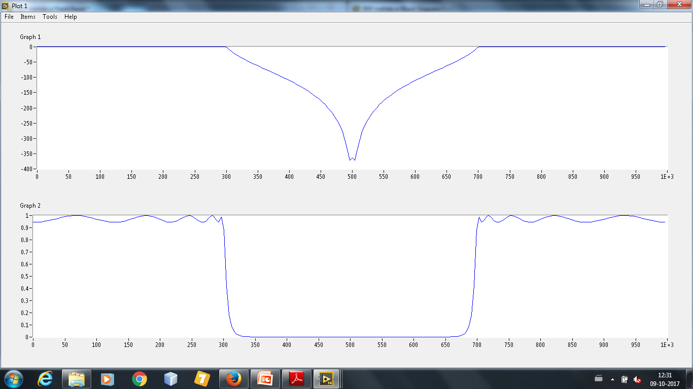
Band Stop Filter

Slide 12
Applications
Reduction of Noise in the ECG signal
Audio Equalizer System to control the voice signal
Filter involving non-linear phase change and high roll-off factors.

Slide 13
Bibliography
Google(https://www.google.com)
National Instruments(http://www.ni.com)
Matworks(http://www.matworks.com)

